Slide 1
TUTORIAL 5
WORKING WITH CASCADING
STYLE SHEETS

Slide 2
OBJECTIVES
In this chapter, you will:
Learn about the history and theory of Cascading Style Sheets
Link a style sheet to an XML document
Design a page layout using styles

Slide 3
OBJECTIVES
In this chapter, you will:
Apply styles to text and text backgrounds
Use a style sheet to create and display background images
Use styles with elements classified by id and class attributes

Slide 4
EXPLORING THE HISTORY OF CSS
A style is a rule that defines the appearance of a particular element in a document
The collection of styles for all elements in a document is called a style sheet
The accepted style sheet standard is Cascading Style Sheets, or CSS
CSS was developed by the World Wide Web Consortium

Slide 5
EXPLORING THE HISTORY OF CSS
The first CSS standard, CSS1, was released in 1996,and established basic styles used in CSS
CSS2 was released in 1998, and added support for printers, sound devices, downloadable forms, layout, and tables
CSS3 plans to modularize the CSS standard, and increase support for non-Western languages and XML namespaces

Slide 6
ATTACHING A STYLE SHEET TO AN XML DOCUMENT
To attach a style sheet to an XML document, the processing instruction should be inserted directly below the first line in the XML file, which specifies the name and location of files containing the style sheet:

Slide 7
DEFINING A STYLE
Each line of the CSS file attaches a collection of styles to an element or group of elements called a selector
For each selector, the CSS style attributes should be specified, and the values are applied to those attributes
Style attributes are passed from parent elements to the descendant elements

Slide 8
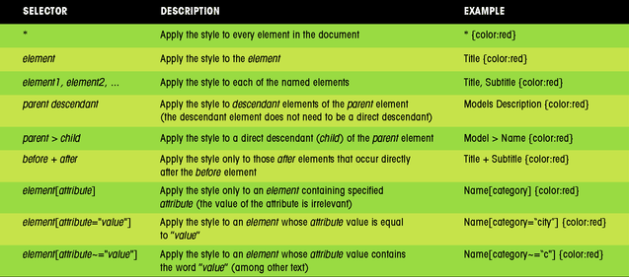
WORKING WITH SELECTORS

Slide 9
WORKING WITH PSEUDO-ELEMENTS AND PSEUDO-CLASSES
A more general class of selectors is the pseudo-element selector, which specifies elements based on a conjunction that does not involve the element’s name
CSS also allows pseudo-class selectors for items in the document that are not elements

Slide 10
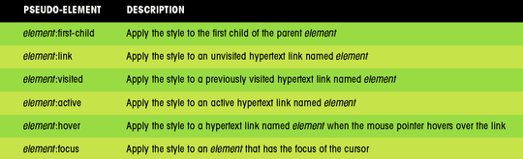
WORKING WITH PSEUDO-ELEMENTS AND PSEUDO-CLASSES
CSS supports seven pseudo-elements

Slide 11
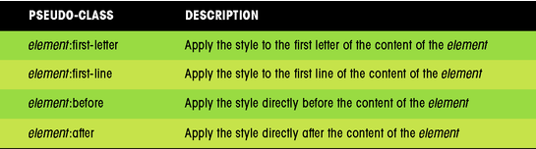
WORKING WITH PSEUDO-ELEMENTS AND PSEUDO-CLASSES
CSS supports four pseudo-classes

Slide 12
WORKING WITH THE DISPLAY ATTRIBUTE
An XML document contains information in distinct sections called blocks, or block-level elements
Without styles the browser displays the content of each XML element inline, as a continuous text string
To display an element’s content inline in a separate block, the style is:
  display: block
To hide an element’s content, the style is:
  display: none

Slide 13
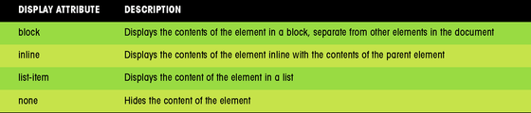

DISPLAY ATTRIBUTE VALUES
Currently, four display values are supported by browsers in conjunction with XML document
Example:

Slide 14
WORKING WITH LIST-ITEMS
To display an element as a list, the style is:
  display: list-item
To control the appearance of the markers in the list, the style is:
  list-style: type position
  where type is the type of markers that will appear with each list-item, and position indicates the position of those markers relative to the list text

Slide 15
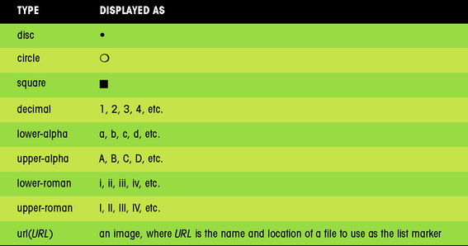
LIST-ITEM TYPES

Slide 16

LIST-ITEM POSITIONS
The position attribute is optional and can have two possible values: inside and outside
  inside – lines up the list item text with the list marker
  outside – places the marker outside of the list text
  Example:

Slide 17
SIZING BLOCK ELEMENTS
To set the width of a block element, use the style:
  width: value
To set the height of an element, use the style:
  height: value
The value is expressed as a percentage of the width/height of the parent element, or in absolute units

Slide 18
POSITIONING ELEMENTS
To place an element at a defined coordinate within its parent element, use the style:
  height: value position: absolute; top:value; left:value
To offset an element from its default location within its parent element, use the style:
  position: relative; top:value; left:value
A fixed position places the element at a fixed location in the display window
A static position places the object in its natural position in the flow of the document, as determined by the browser

Slide 19
FLOATING AN ELEMENT
To place an element on its parent element’s left or right margin (and then to flow the succeeding text around the element), use the style:
  float: margin
  where margin is either left or right
To prevent another element from wrapping the floating element, use the style:
  clear: margin
  where margin is either left, right, or both

Slide 20
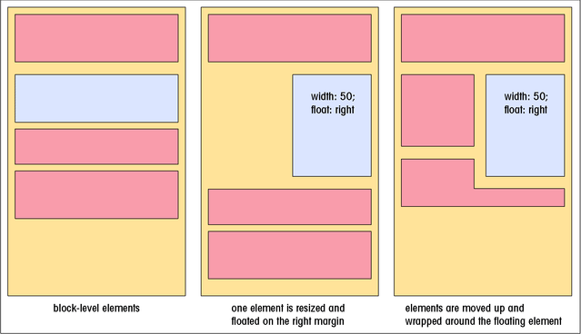
FLOATING A BLOCK-LEVEL ELEMENT

Slide 21
USING THE CLEAR ATTRIBUTE

Slide 22
STACKING ELEMENTS
By default, elements defined later in the XML document are placed on top of earlier elements
You can specify a different stacking order using the z-index attribute
The highest z-index values placed on top
The z-index attribute is applied only when elements share the same parent

Slide 23
WORKING WITH COLOR
Color can be expressed by a color name or a value
CSS supports 16 color names
Color values can be expressed using the triplet of numbers:
  rgb (red, green, blue)
  where red, green, and blue are numeric values indicating the intensity of primary colors
Color values can be expressed as percentages:
  rgb (red%, green%, blue%)

Slide 24
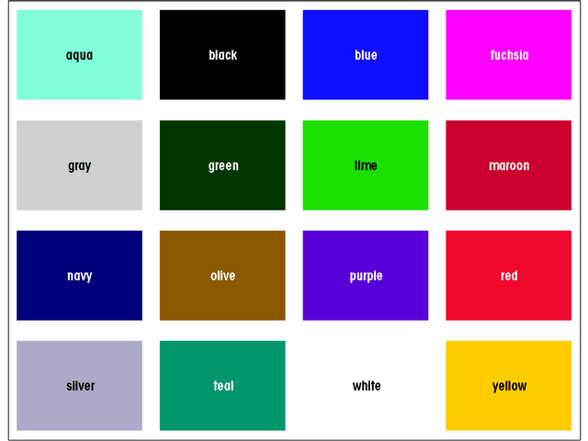
THE 16 BASIC CSS COLOR NAMES

Slide 25
APPLYING A BACKGROUND COLOR
To set the font color of an element, use the style:
  color: color
To set the background color of an element, use the style:
  background-color: color
  where color is either a color name or a color value

Slide 26
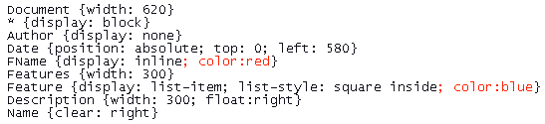
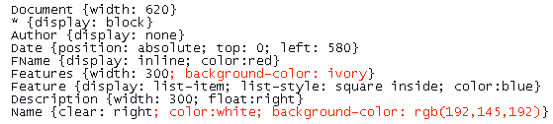
STYLE EXAMPLES
Changing the font color:
Specifying a background color

Slide 27
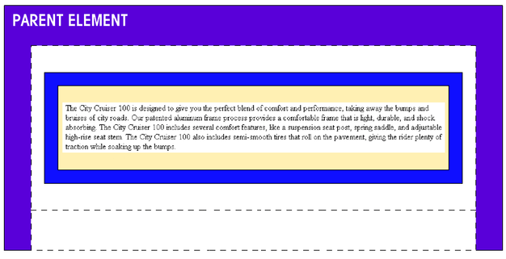
WORKING WITH BORDERS, MARGINS, AND PADDING
Each block-level element is composed of four parts: the margin between the box and other elements, the border of the box, the padding between the element’s content and the border, and the element content.
element content
padding
border
margin

Slide 28
WORKING WITH MARGINS
CSS supports four attributes that can be used to control the size of the margin of a block-level element
The size of the margin expressed in absolute units, or as a percentage of the width of the parent element
The four margin attributes can be combined into a single attribute with the style:
  margin: top right bottom left

Slide 29
WORKING WITH BORDERS
A border with the thickness, color, and style can be created around any element
Styles can be applied to individual borders, or all four borders at once
Border widths can be expressed in absolute units of length, as a percentage of the parent element, or defined with the keywords: “thin”, “medium”, or “thick”

Slide 30
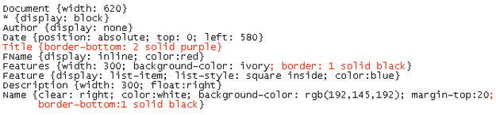
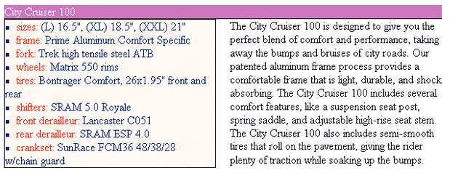
ADDING BORDER STYLES

Slide 31
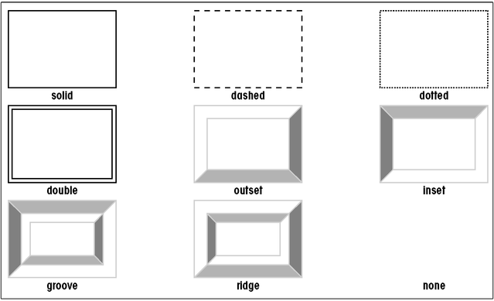
BORDER STYLES

Slide 32
WORKING WITH PADDING
An increase of the size of the padding increases the space between the element content and the border
Padding values can be expressed in absolute units, or as a percentage of the width of the block-level element
There are four padding attributes: padding-top, padding-right, padding-bottom, and padding-left
The four padding attributes can be combined into a single attribute with the style:
  padding: top right bottom left

Slide 33
SETTING FONT AND TEXT ATTRIBUTES
CSS supports different fonts, font sizes, and font styles to make XML documents more readable and interesting
CSS controls spacing between letters, words, and lines of text
CSS allows to align text horizontally and vertically
There are special attributes to indent and decorate the element’s text

Slide 34
USING FONT FAMILIES
The style to change the font of an element is:
  font-family: fonts
  where fonts is a list of possible fonts,separated by commas
CSS works with two types of fonts: specific and generic
A generic font is a general description of the font, allowing the operating system to determine which installed font best matches the description

Slide 35
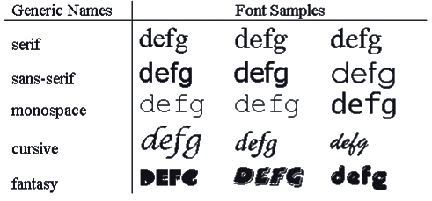
GENERIC FONTS

Slide 36
MANAGING FONT SIZES
The style for setting font size is:
  font-size: value
  where value is the size of the font keyword description
Font sizes can be expressed as:
  A unit of length
  A keyword description
  A percentage of the size of the element
  A size relative to the default font size of the element

Slide 37
CONTROLLING WORD, LETTER, AND LINE SPACING
The letter-spacing attribute controls the amount of space between letters, or kerning
The word-spacing attribute controls the space between words, or tracking
The line-height attribute controls the amount of space between lines of text, or leading

Slide 38
SETTING FONT STYLES AND WEIGHTS
To specify appearance for an element’s font in CSS, the style is:
  font-style: type
  where type is either normal, italic, or oblique
To specify the font’s weight, the style is:
  font-weight: value
  where value is a number ranging from 100 to 900 in intervals of 100, a keyword describing the font’s weight (normal or bold), or a keyword that describes the weight relative to the weight of the parent element’s font (lighter or bolder)

Slide 39
ALIGNING TEXT HORIZONTALLY AND VERTICALLY
To align text horizontally, the style is:
  text-align: alignment
  where alignment is either left, right, or justify
To align text vertically relative to the baseline of the parent element, the style is:
  vertical-align: alignment
where alignment is baseline, bottom, sub, super, text- bottom, text-top,or top is expressed as a distance or percentage that the element is raised or lowered to the height of the parent element

Slide 40
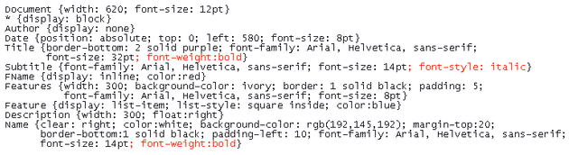
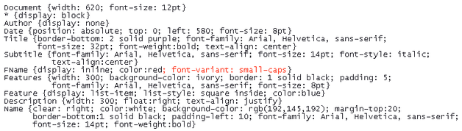
APPLYING FORMATTING

Slide 41
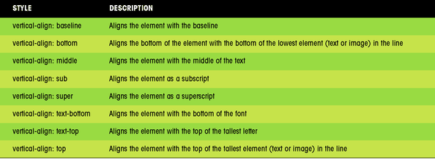
VERTICAL-ALIGN VALUES

Slide 42
WORKING WITH SPECIAL TEXT ATTRIBUTES
To decorate the element’s text, the style is:
  text-decoration: type
  where type is blink, line-through, overline, underline, or none
To change the case of the text font, the style is:
  text- transform : type
  where type is capitalize, lowercase, uppercase, or none
To display a variant of the font’s original appearance, the style is:
  text- variant : type
  where type is small-caps or none

Slide 43
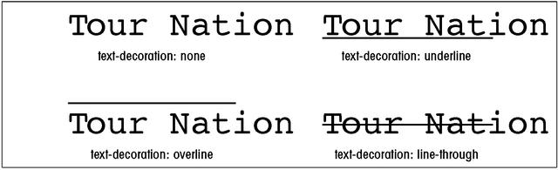
VALUES OF THE TEXT-DECORATION STYLE

Slide 44
USING THE FONT ATTRIBUTES
The font style combines many of the text and font attributes into a single style:
  font: font-style font-weight font-variant font- size/font-height font-family
The font size, font weight, and font variant attributes are required, while the order attributes are optional
The font style provides an efficient way to define multiple attributes

Slide 45
ADDING BACKGROUND IMAGES
To add a background image to an element, the style is:
  background-image: url (URL)
  where URL is the location/filename of a background image
There are four properties that can be set with a background image:
  the source of the image file
  where the image is placed in the background of the element
  how the image is repeated across the background of the element
  whether the image scrolls with the display window

Slide 46
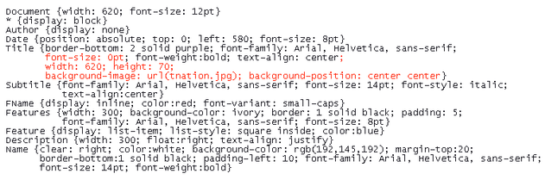
ADDING A BACKGROUND IMAGE
EXAMPLE

Slide 47
WORKING WITH IDS AND CLASSES
The id and class attributes are features of HTML used to distinguish one HTML tag from another
The id attribute identifies a unique tag in a document, while class attribute identifies several tags belonging to the same group or class
The id attribute must be different for each tag, but tags can share the same class value

Slide 48
WORKING WITH IDS AND CLASSES
CSS allows you to create styles based on the id and class names of the tags from the HTML file
You can distinguish different applications of the same class by including the element name
If you do not include the element name, the style is applied to all elements that use that class value

Slide 49
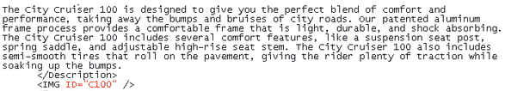
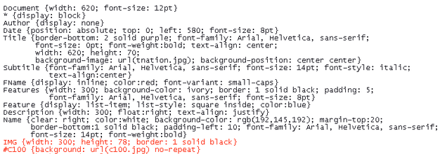
ADDING ID ATTRIBUTE EXAMPLE

Slide 50
MIXING HTML AND XML
To add HTML tags to an XML document, first add the namespace http://www.w3.org/TR/REC-html40 to the XML document
An XML processor recognizes any tag associated with this namespace as an HTML tag, and a browser treats those tags as if they came from an HTML file
Mixing HTML and XML allows to place an inline images into an XML document and create hypertext links

Slide 51
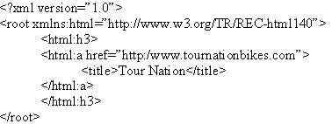
MIXING HTML AND XML
Hyperlink example:

Slide 52
SUMMARY
Style sheets improve the format and appearance of Web pages
Style sheets use a common language and syntax of the standard, Cascading Style Sheets, or CSS
Several style sheets can be attached to a single XML document by adding processing instructions

Slide 53
SUMMARY
Each line of the CSS file attaches a collection of styles to a selector
Styles perform tasks such as formatting the text, creating and displaying background images
The id and class attributes allow to distinguish one HTML tag from another and apply a style to a particular id/class element

